Slide 1
Object Oriented Programming—C++ Lecture9 Advanced Topics(1)
Qijun Zhao
College of Computer Science
Sichuan University
Spring 2025

Slide 2
Table of Context
Lambda functions
Smart pointer
Unique pointer
Shared pointer
Weak pointer

Slide 3
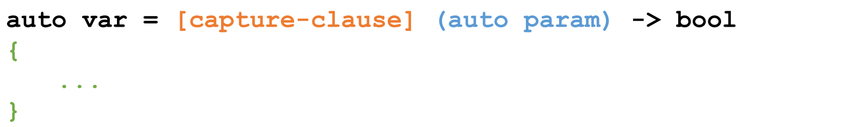
Lambdas Function
Lambdas are inline, anonymous functions that can know about functions declared in their same scope!
Outside parameters
go here
Specifies that
Type is generic
Function body
goes here!

Slide 4
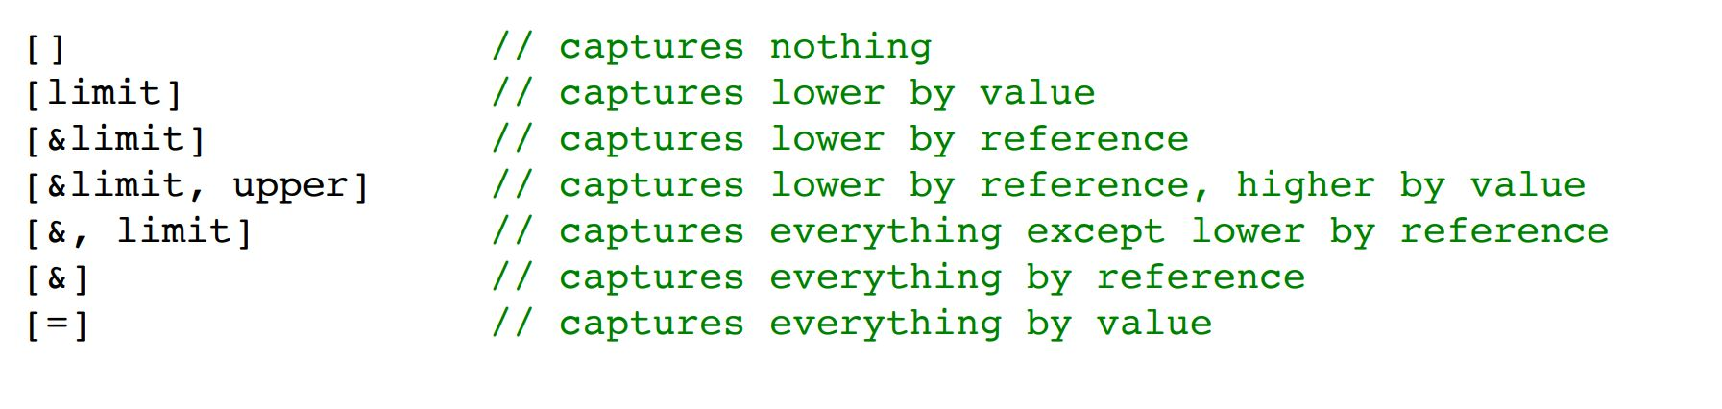
Capture Clauses
You can capture any outside variable, both by reference and by value.
● Use just the = symbol to capture everything by value,
and just the & symbol to capture everything by reference

Slide 5
Using Lambdas
Lambdas are pretty computationally cheap and a great tool!
● Use a lambda when you need a short function or to access local variables in your function.
● If you need more logic or overloading, use function pointers.
● In fact, a lambda function can be seen as an anonymous class with overloading operator ().

Slide 6
Smart pointers
Smart pointer is a pointer-like type with some additional functionality, e.g. automatic memory deallocation (when the pointer is no longer in use, the memory it points to is deallocated), reference counting, etc.
C++11 provides three smart pointer types:
• std::unique_ptr
• std::shared_ptr
• std::weak_ptr
Smart pointers prevent most situations of memory leaks by making the memory deallocation automatic.
Notes:
RAII（Resource Acquisition Is Initialization）是由c++之父Bjarne Stroustrup提出的，中文翻译为资源获取即初始化，他说：使用局部对象来管理资源的技术称为资源获取即初始化；这里的资源主要是指操作系统中有限的东西如内存、网络套接字等等，局部对象是指存储在栈的对象，它的生命周期是由操作系统来管理的，无需人工介入。
资源的使用一般经历三个步骤a.获取资源 b.使用资源 c.销毁资源，但是资源的销毁往往是程序员经常忘记的一个环节，所以程序界就想如何在程序员中让资源自动销毁呢？c++之父给出了解决问题的方案：RAII，它充分的利用了C++语言局部对象自动销毁的特性来控制资源的生命周期。

Slide 7
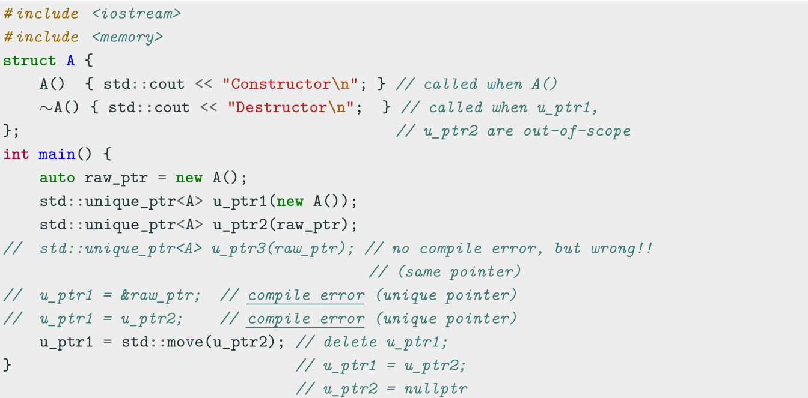
std::unique ptr - Unique Pointer
std::unique_ptr is used to manage any dynamically allocated object that is not shared by multiple objects

Slide 8
std::unique ptr - Unique Pointer
std::unique_ptr methods
• get() returns the underlying pointer
• operator* operator-> dereferences pointer to the managed object
• operator[] provides indexed access to the stored array (if it supports random
access iterator)
• release() returns a pointer to the managed object and releases the ownership
• reset(ptr) replaces the managed object with ptr
Utility method: std::make unique<T>() creates a unique pointer of a class T
that manages a new object

Slide 9
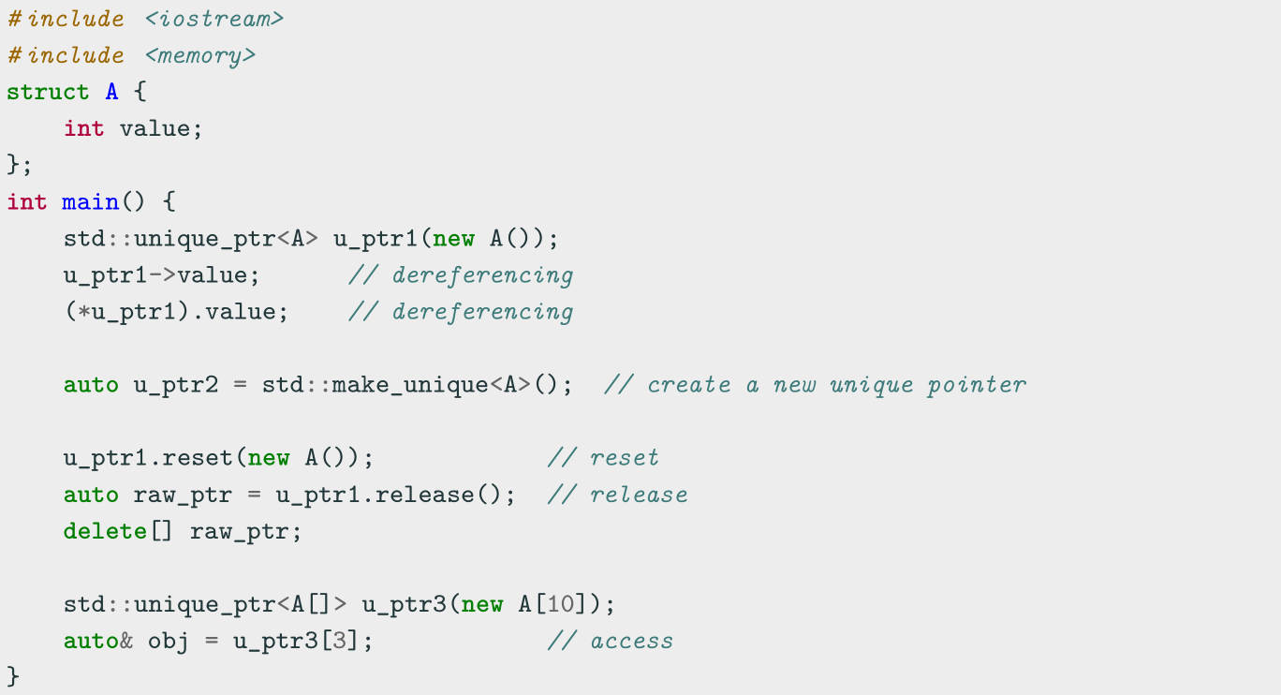
std::unique ptr - Unique Pointer

Slide 10
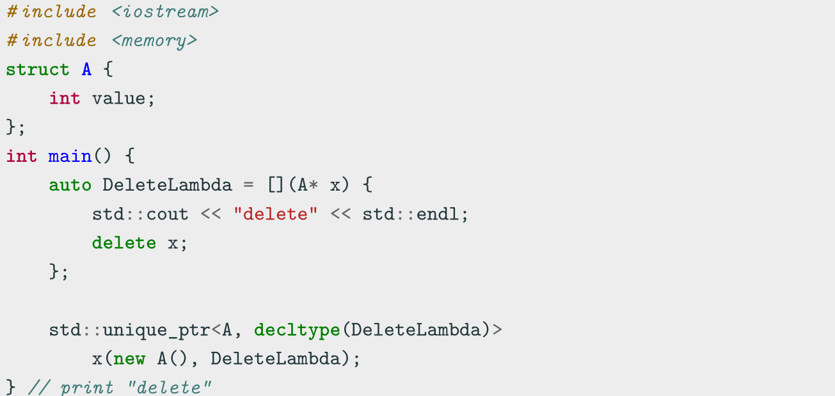
std::unique ptr - Unique Pointer
Implement a custom deleter

Slide 11
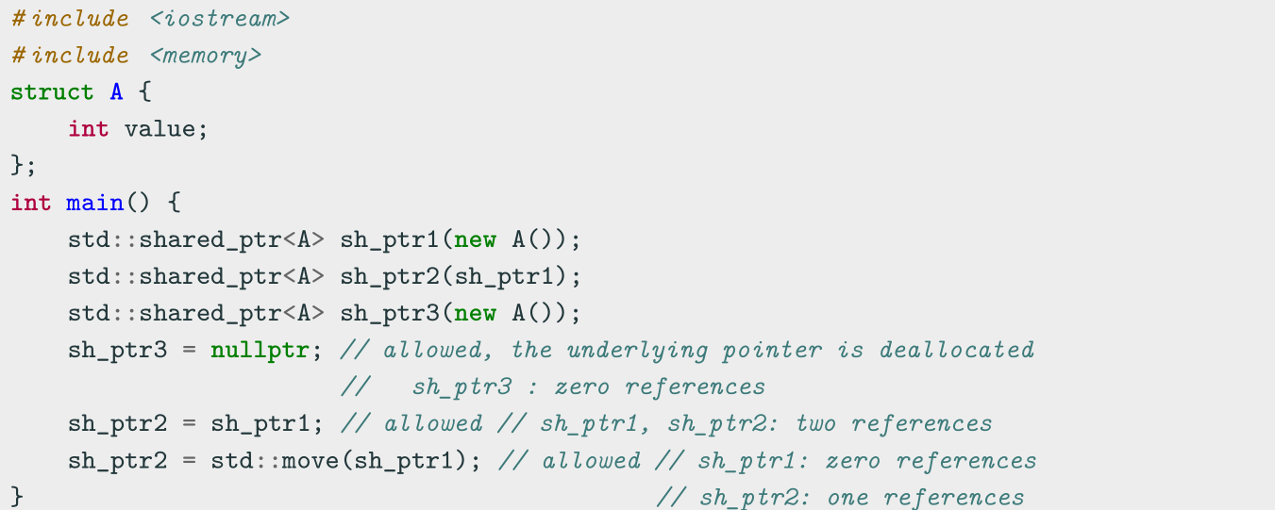
std::shared ptr - Shared Pointer
std::shared ptr is the pointer type to be used for memory that can be owned by multiple resources at one time
std::shared ptr maintains a reference count of pointer objects. Data managed by
std::shared ptr is only freed when there are no remaining objects pointing to the data

Slide 12
std::shared ptr - Shared Pointer
std::shared ptr methods
• get() returns the underlying pointer
• operator* operator-> dereferences pointer to the managed object
• use count() returns the number of objects referring to the same managed object
• reset(ptr) replaces the managed object with ptr
Utility method: std::make shared() creates a shared pointer that manages a new
object

Slide 13
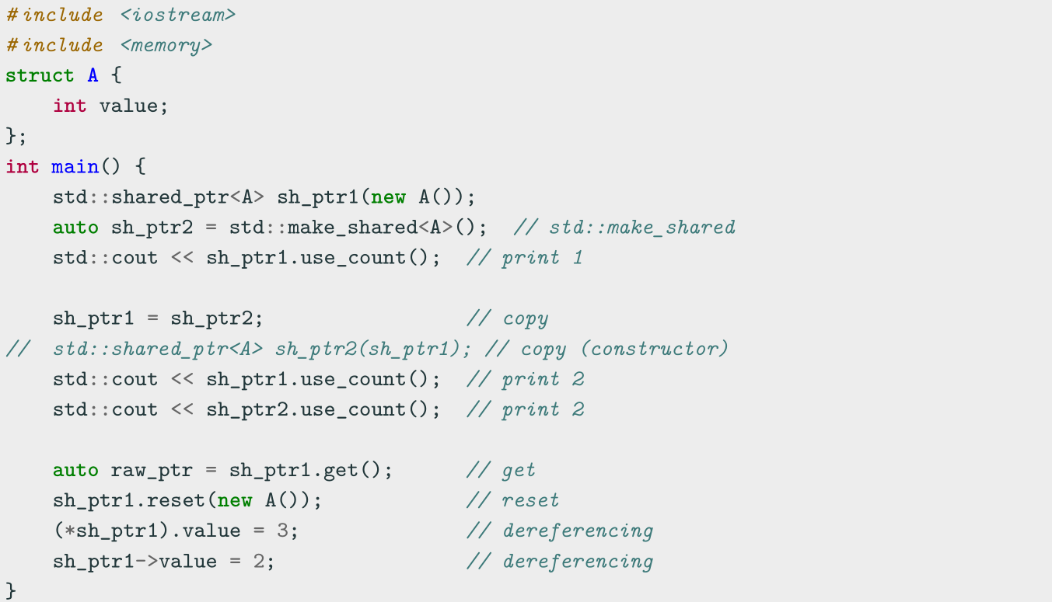
std::shared ptr - Shared Pointer

Slide 14
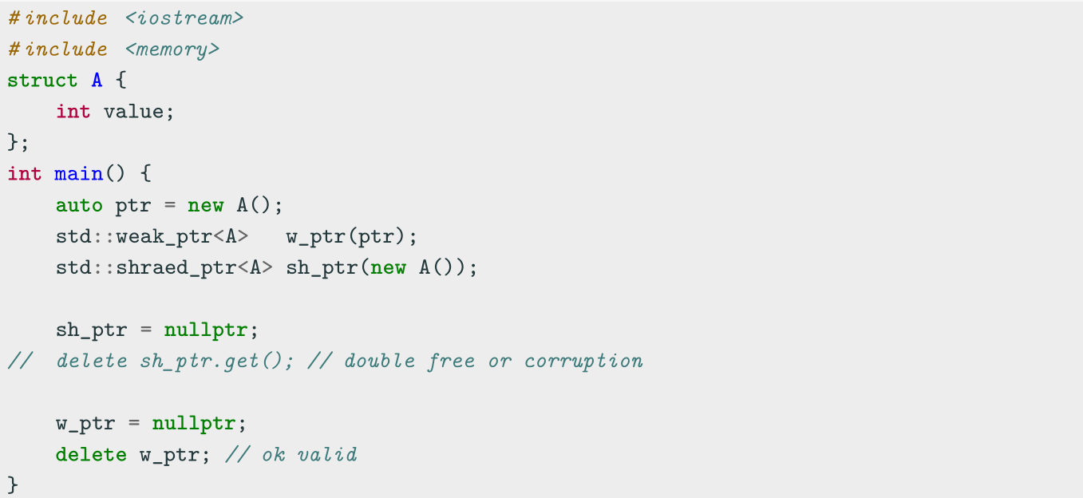
std::weak ptr - Weak Pointer
A std::weak ptr is simply a std::shared ptr that is allowed to dangle (pointer not deallocated)

Slide 15
std::weak ptr - Weak Pointer
It must be converted to std::shared ptr in order to access the referenced object
std::weak ptr methods
• use count() returns the number of objects referring to the same managed object
• reset(ptr) replaces the managed object with ptr
• expired() checks whether the referenced object was already deleted (true, false)
• lock() creates a std::shared ptr that manages the referenced object

Slide 16
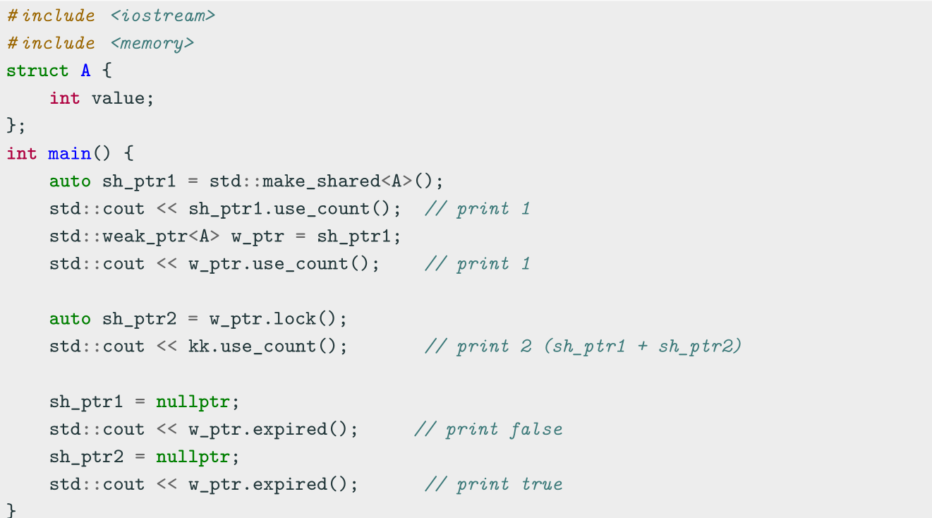
std::weak ptr - Weak Pointer

Slide 17
Coding to make the world better
Qijun Zhao
qjzhao@scu.edu.cn

